Slide 1

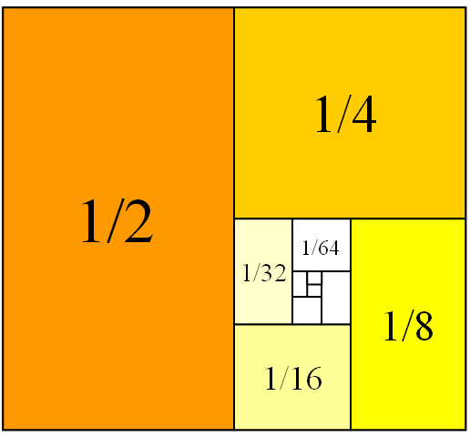
Mathematics for Engineering: Calculus
Chapter 6: Power Series
(Chuỗi lũy thừa)
Department of Mathematics, FPT University

Slide 2
Introduction
Topics :
  6.1 Power series and Functions
  6.3 Taylor and Maclaurin series

Slide 3
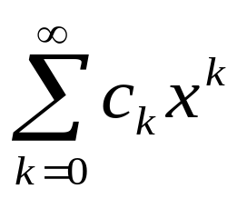
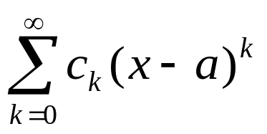
6.1 Power series and Functions
Definition
Power series is a series of the form:
where x is a variable, and c_{k} are constants called the coefficients of the series.
Power series centered at a is a series of the form:

Slide 4
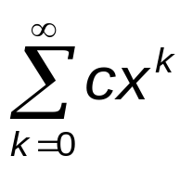
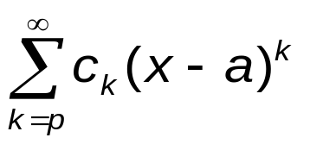
6.1 Power series and Functions
Power series
Example
Geometric series:
The series is not called a power series if p< 0.

Slide 5
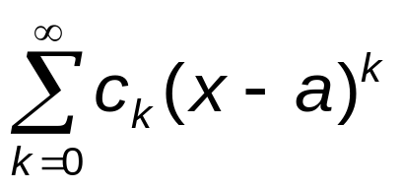
6.1 Power series and Functions
Power series
Theorem
Let be a power series centered at a. There are
only three possibilities:
The series converges only when x= a.
The series converges for all x.
There is a positive number R such that the series converges if |x-a|<R and diverges if |x-a|>R.

Slide 6
6.1 Power series and Functions
Power series
Definition
The radius of convergence of the power series
is the number R such that the series converges for |x – a| < R and diverges for |x – a| > R.
Interval of convergence of the power series is the interval that consists of all x for which the series converges.

Slide 7
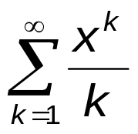
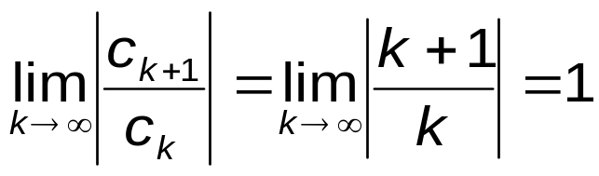
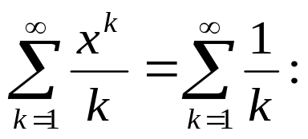
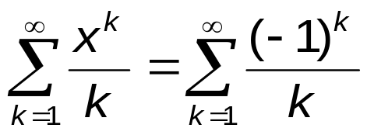
6.1 Power series and Functions
Power series
Example
Find the radius and interval of convergence of the series
→ R = 1
→ the series converges when −1<x<1
At x = 1
Harmonic series diverges
At x = −1
Alternating series converges
→ the interval of convergence is [-1,1).

Slide 8
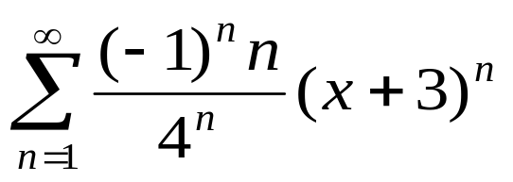
6.1 Power series and Functions
Power series
Example
Find the radius and interval of convergence of the series

Slide 9
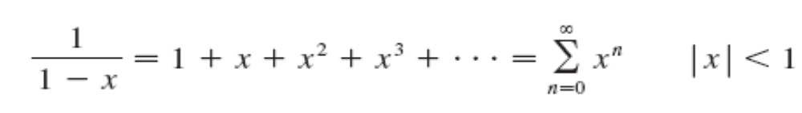
6.1 Power series and Functions
Representing functions as Power Series
Example
We have known:
→ The function 1/(1-x) can be expressed as a power series on interval of convergence.

Slide 10
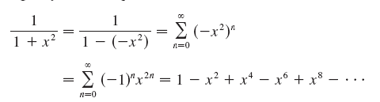
6.1 Power series and Functions
Representing functions as Power Series
Example
Express 1/(1+x²) as a power series and find the interval of convergence.
Solution:
Interval of convergence: (-1, 1)

Slide 11
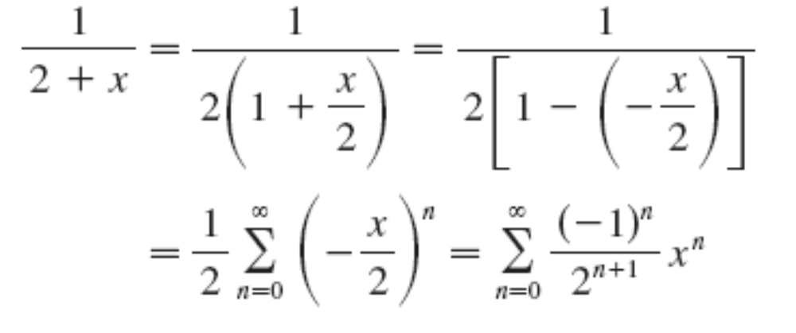
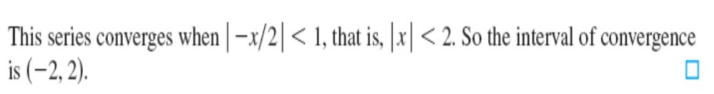
6.1 Power series and Functions
Representing functions as Power Series
Example
Express 1/(2+x) as a power series and find the interval of convergence.
Solution:

Slide 12
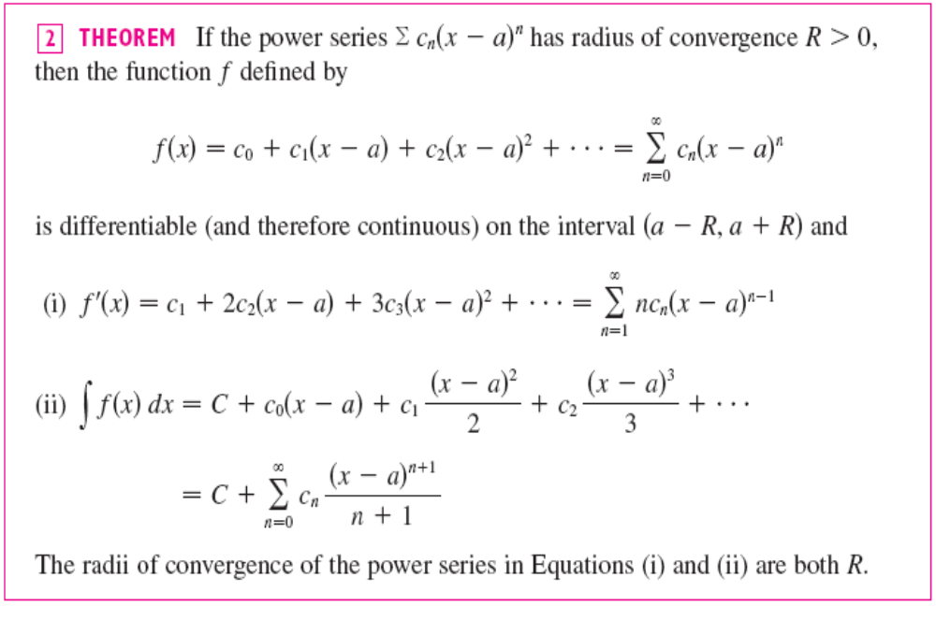
Differentiating and Integrating Power Series

Slide 13
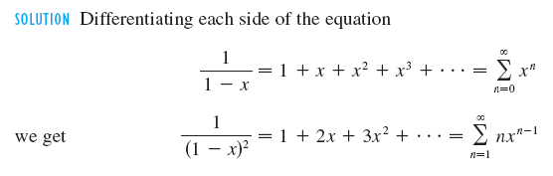
Differentiating and Integrating Power Series
Example
Express 1/(1-x)² as a power series and find the interval of convergence.

Slide 14
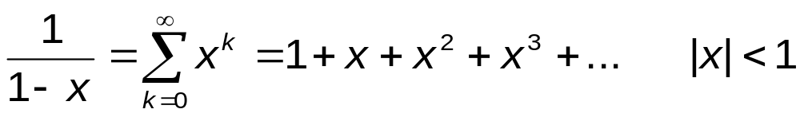
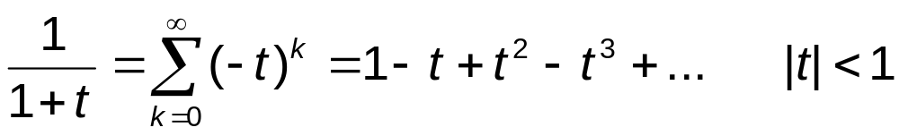
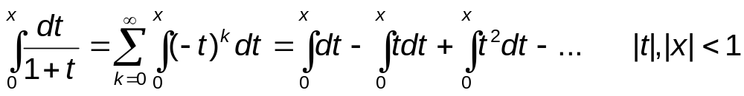
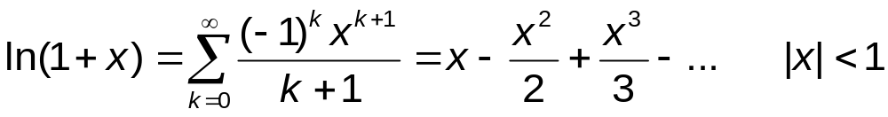
Differentiating and Integrating Power Series
Example
Find the representation of ln(1+x) from that of 1/(1−x).

Slide 15
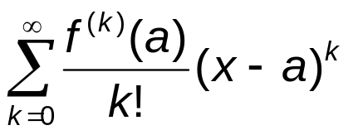
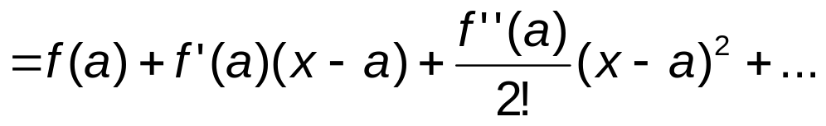
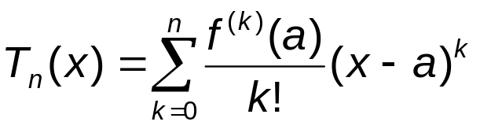
6.3 Taylor and Maclaurin series
Definition
Taylor series of the differentiable function f(x):R→R at x=a is:
When a = 0, it is called Maclaurin series.
The nth-degree Taylor polynomial of f(x) at a:

Slide 16
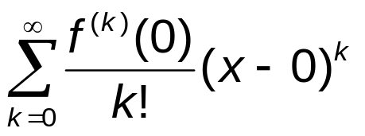
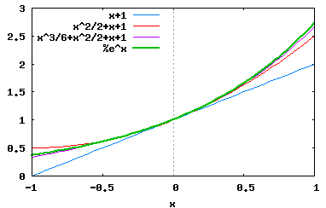
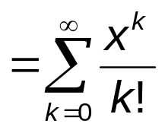
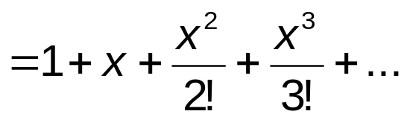
6.3 Taylor and Maclaurin series
Example
Find the Taylor series of e^{x} at x = 0.
If f(x) = e^{x}, then f^{(k)}(x) = e^{x} → Taylor series at x=0 is:

Slide 17
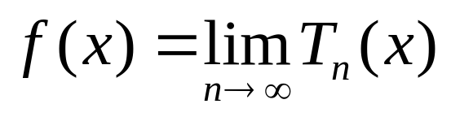
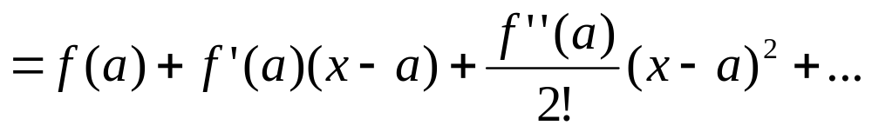
6.3 Taylor and Maclaurin series
Theorem
Let f(x):R→R be a function differentiable at x = a.
Let R_{n}(x) = f(x) - T_{n}(x), where T_{n}(x) is the n^{th} degree Taylor polynomial at x = a. We call R_{n}(x) the remainder of the Taylor series.
If lim_{n→∞}R_{n}(x)=0 for |x − a| < R then f(x) = sum of its Taylor series for |x − a| < R, meaning

Slide 18
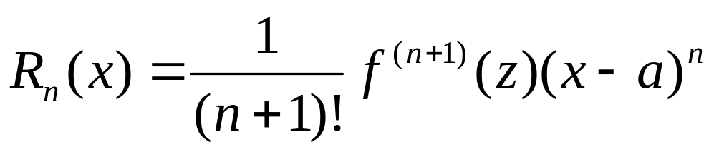
6.3 Taylor and Maclaurin series
Taylor’s Fomular
If f(x) has n+1 derivatives on an interval I that contains the number a, then for x in I there is a number a < z < x such that :
Example
Show that the function e^{x} equals its Taylor series at a = 0.

Slide 19
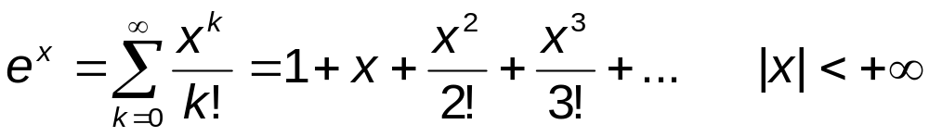
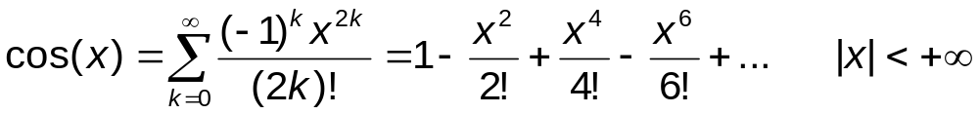
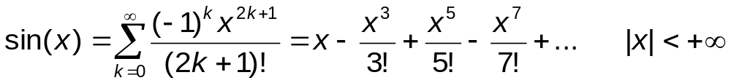
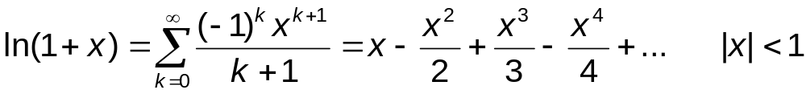
6.3 Taylor and Maclaurin series
Example

Slide 20
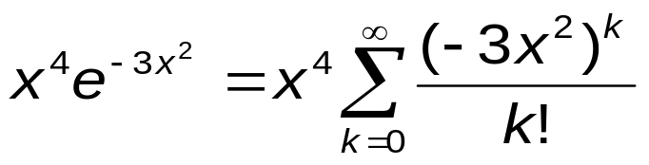
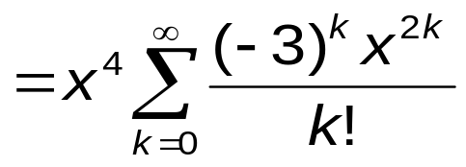
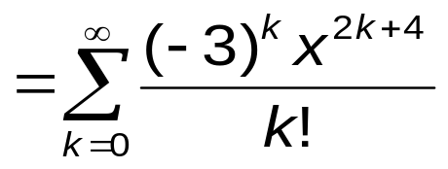
6.3 Taylor and Maclaurin series
Example
Find a power series representation for x⁴e^{-3x2} at x = 0?
Using the Maclaurin series for e^{x} at x = 0, we have

Slide 21
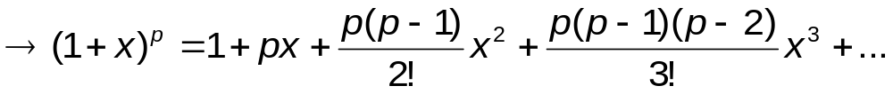
6.3 Taylor and Maclaurin series
Example
Find the Taylor series of (1+x)^{p} at x = 0?
  f ’(x)=p(1+x)^{p-1} f ’(0)=p
  f ’’(x)=p(p-1)(1+x)^{p-2} f ’’(0)=p(p-1)
  f ⁽³⁾(x)=p(p-1)(p-2)(1+x)^{p-3} f ⁽³⁾(0)=p(p-1)(p-2)
  …
  f ^{(k)}(x)=p(p-1)…(p-n+1)(1+x)^{p-k} f ^{(n)}(0)=p(p-1)…(p-k+1)

Slide 22
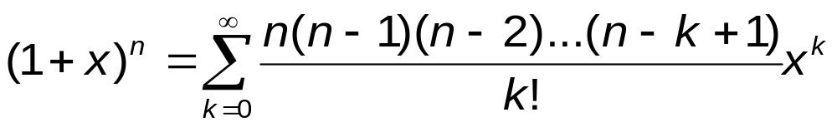
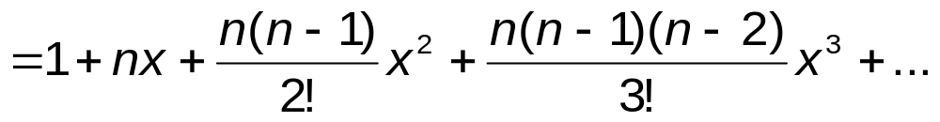
6.3 Taylor and Maclaurin series
Theorem
When |x| < 1, then (1+x)^{n} (n is any real number) can be represented by the binomial series.

Slide 23

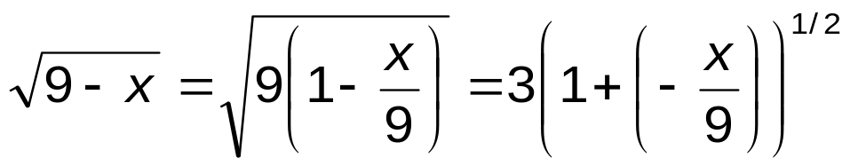
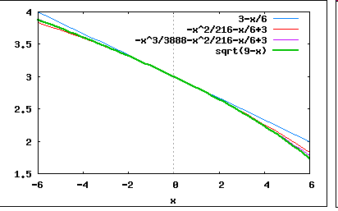
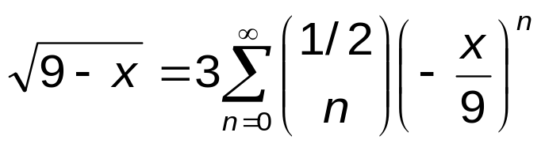
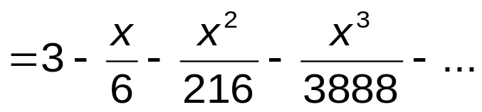
6.3 Taylor and Maclaurin series
Example
Find the binomial series of .
|−x/9| < 1
↔ |x| < 9

Slide 24
Summary
We have studied:
  Power series
  Taylor and Maclaurin series

